Slide 1




WASCOOT
WEB APPLICATION
Wascoot Team
Alberto Crivellari
Paria Tahan
Sara Niknamhesar
Sree Shalini Mada
Shiva Gharehzad
Borwoei Huang
Nick Kuijpers
Nicola Ferro
June 2023
Notes:
Here we see two new concepts, smart contracts and sharding-based blockchain.
JENGA focus on orchestrating logic storage, state storage and execution layer differently from the other benchmark systems to handle efficiently the processing of smart contracts on sharding-based blockchain.

Slide 2
Presentation Outline
01
Project scope
02
What is Wascoot ?
03
The Backend
04
The Frontend
05
Conclusion

Slide 3
Project scope
01
Seven students, first year Master
02
Second semester development
03
Two iterations
04
Agile organisation
Notes:
Agile organisation : weekly meetings, notes taken, standup meeting, goals achieved, continuous development, etc bullshit that our organisation was perfect

Slide 4

What is Wascoot ?
01
Assists managers in the scooter business with their daily operations
02
Information about the scooters, racks and customers
03
Informed business decisions
04
Streamlines business processes
Notes:
Streamlines business processes, increasing
efficiency and profitability

Slide 5

Backend
01
PostgreSQL DB
02
MVC Design Pattern
03
JSP - REST communication to frontend
03
Authentication and filter
Notes:
To authenticate the user must provide the
password
The password is mixed with a 10 characters salt
Therefore there is no clear password saved in the
database, this allows to increase the safety
FILTER: When the user login a session is created
The session is used by the application
filters to validate the
access to the protected pages
There are different filters, each for every
possible user role in the web application

Slide 6
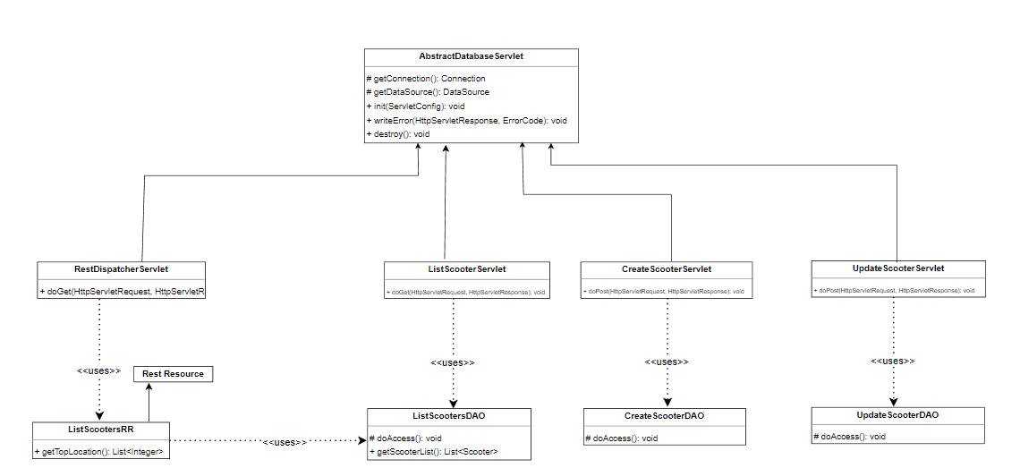
Backend example
Class diagram
Notes:
Streamlines business processes, increasing
efficiency and profitability

Slide 7
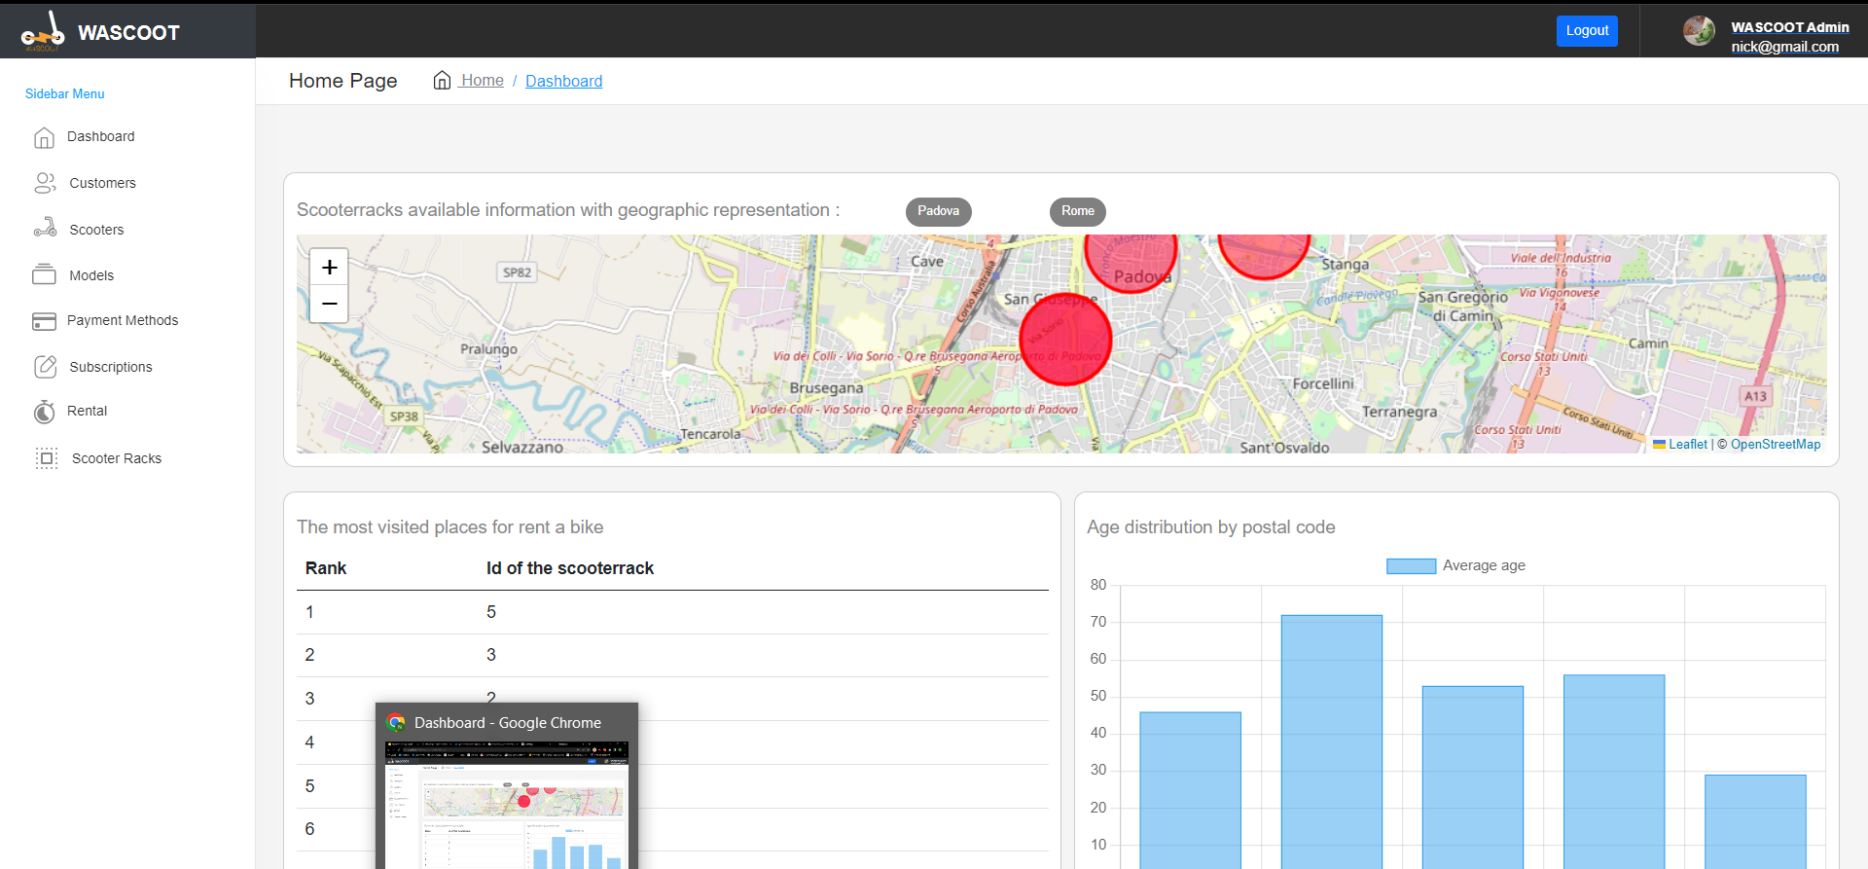
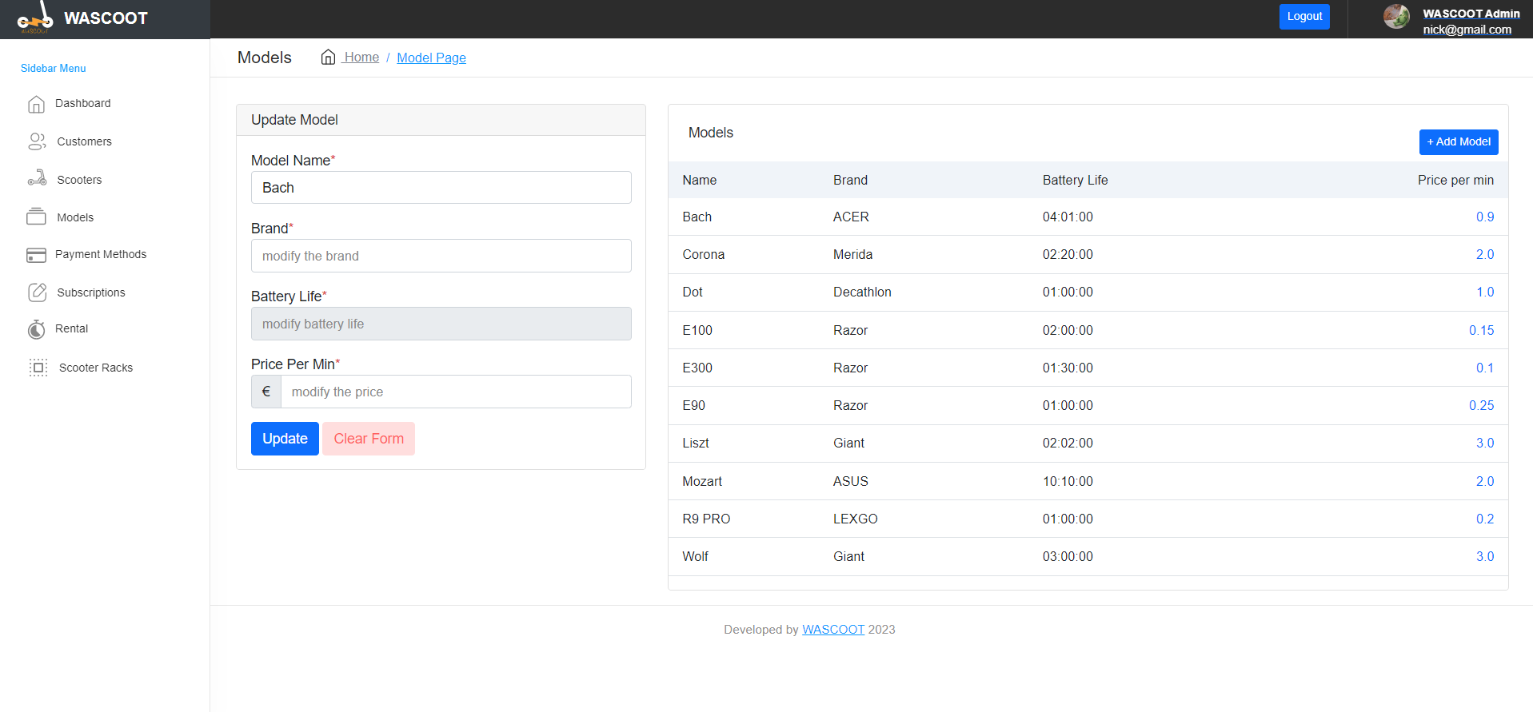
Frontend
01
Menu, header and navigation bar
02
Charts
03
Map implementation
Notes:
The header contains the logo and the title of the project, together with the Login and Sign in buttons. The logo also operate as homepage button
Once the user has logged in, it appears a personalized welcome message together with a Logout button
The header also contains the navigation bar, which is
accessible only after the user's login
NAVBAR:The navigation bar is set to be right at the bottom of the header
The navbar is personalized for each kind of user's role, showing different links
The mobile version is provided with a button, that enable the user to
show/hide the navigation bar at will

Slide 8
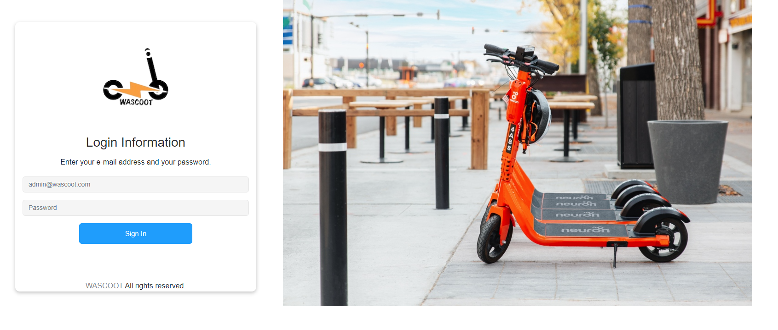
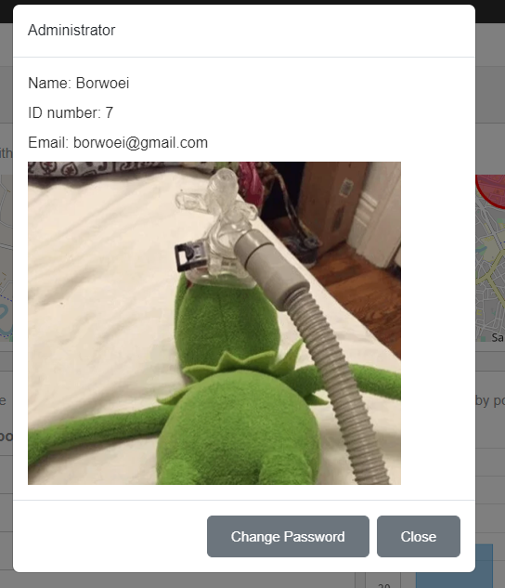

Frontend
01
Login
02
Logout
03
Admin information popup
Notes:
The header contains the logo and the title of the project, together with the Login and Sign in buttons. The logo also operate as homepage button
Once the user has logged in, it appears a personalized welcome message together with a Logout button
The header also contains the navigation bar, which is
accessible only after the user's login
NAVBAR:The navigation bar is set to be right at the bottom of the header
The navbar is personalized for each kind of user's role, showing different links
The mobile version is provided with a button, that enable the user to
show/hide the navigation bar at will

Slide 9
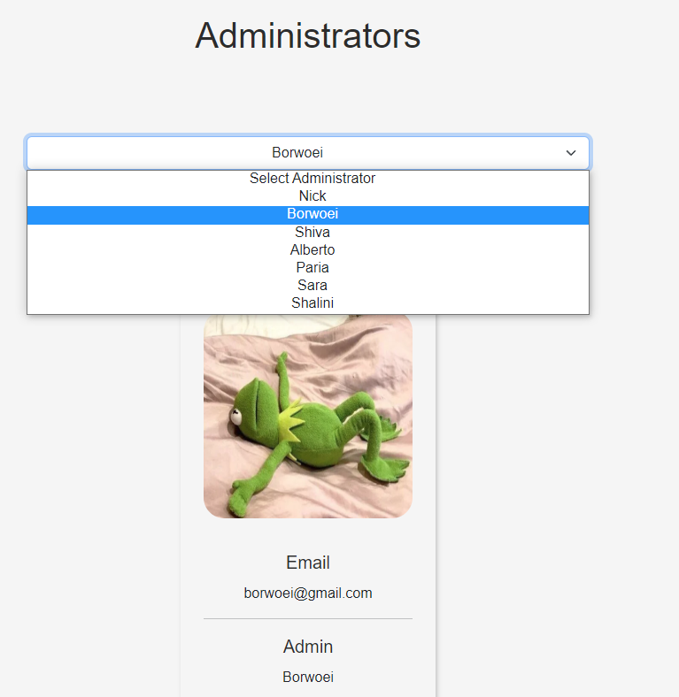
Frontend
01
Admins personal page
Notes:
The header contains the logo and the title of the project, together with the Login and Sign in buttons. The logo also operate as homepage button
Once the user has logged in, it appears a personalized welcome message together with a Logout button
The header also contains the navigation bar, which is
accessible only after the user's login
NAVBAR:The navigation bar is set to be right at the bottom of the header
The navbar is personalized for each kind of user's role, showing different links
The mobile version is provided with a button, that enable the user to
show/hide the navigation bar at will

Slide 10
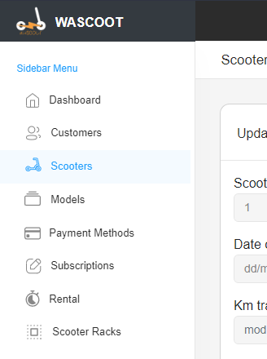
Frontend
01
Manage Pages
02
List table
03
Add and Update
Notes:
The header contains the logo and the title of the project, together with the Login and Sign in buttons. The logo also operate as homepage button
Once the user has logged in, it appears a personalized welcome message together with a Logout button
The header also contains the navigation bar, which is
accessible only after the user's login
NAVBAR:The navigation bar is set to be right at the bottom of the header
The navbar is personalized for each kind of user's role, showing different links
The mobile version is provided with a button, that enable the user to
show/hide the navigation bar at will

Slide 11
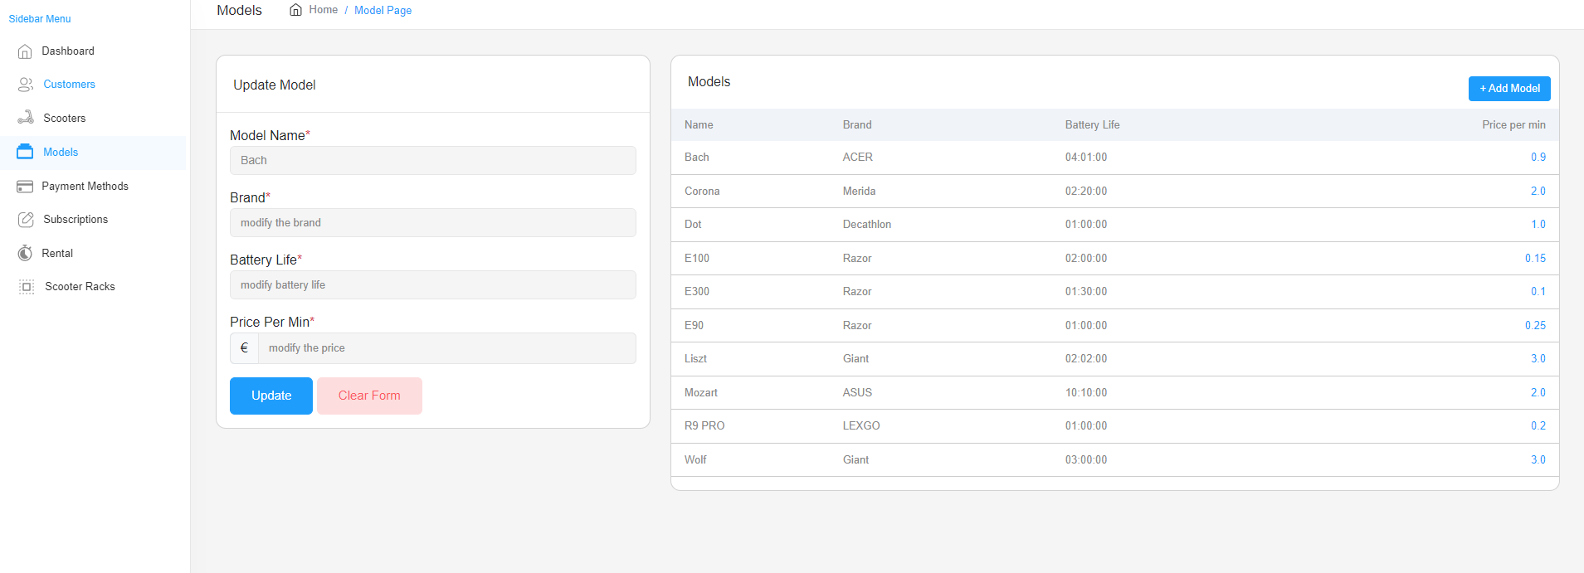
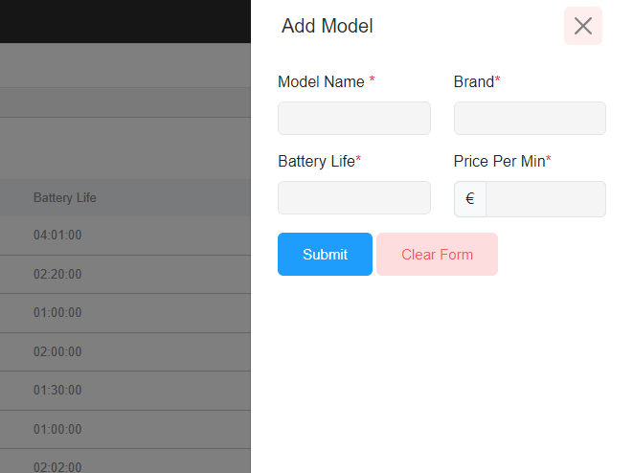
Frontend
Notes:
The header contains the logo and the title of the project, together with the Login and Sign in buttons. The logo also operate as homepage button
Once the user has logged in, it appears a personalized welcome message together with a Logout button
The header also contains the navigation bar, which is
accessible only after the user's login
NAVBAR:The navigation bar is set to be right at the bottom of the header
The navbar is personalized for each kind of user's role, showing different links
The mobile version is provided with a button, that enable the user to
show/hide the navigation bar at will

Slide 12
Frontend
01
Menu, header and navigation bar
02
Charts
03
Map implementation
Notes:
The header contains the logo and the title of the project, together with the Login and Sign in buttons. The logo also operate as homepage button
Once the user has logged in, it appears a personalized welcome message together with a Logout button
The header also contains the navigation bar, which is
accessible only after the user's login
NAVBAR:The navigation bar is set to be right at the bottom of the header
The navbar is personalized for each kind of user's role, showing different links
The mobile version is provided with a button, that enable the user to
show/hide the navigation bar at will

Slide 13

Frontend example
We will present our application
Notes:
User login
Homepage
Manage Pages
Special details

Slide 14



Thank you for the attention
Any questions
Any doubts ?
Notes:
smart contracts
sharding based blockchain

